Slide 1

Object-Oriented Programming Discussion, Lecture, & Lab Eric Pogue
Agenda for Thursday, January 16th at 2pm CT:
Assignment
Friendly Conversation Topic
Sprint 1 Assignments Q&A
Demos
Coding Standards
Assignment for Next Class
Lab
Discussion & Questions welcome at any time… please be present with no phones or email during our time together

Slide 2
Assignment for Today
Complete Activity List items through item 8 before our next class and be prepared to discuss them
Take your name tags with you and bring them back to class through the end of Sprint 2

Slide 3
Friendly Conversation Topic – OOP Web Development

Slide 4
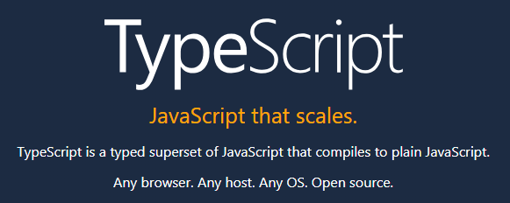

Slide 5
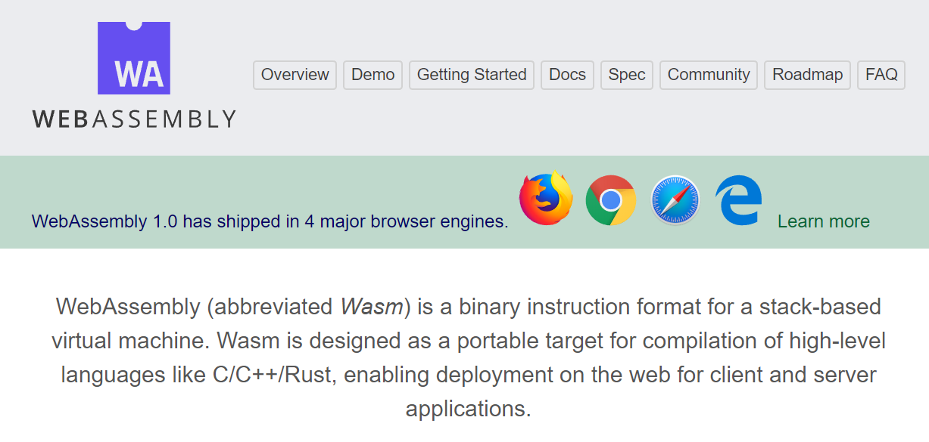

Slide 6
Sprint 1 Assignments Q&A
Notes:
Our Sprint 1 Sprint Planning will be Thursday.

Slide 7
Upcoming Demos
Notes:
Grace period until Monday morning a 6am CT

Slide 8
Demo Guidelines – Presenter
Everyone will give at least one demo of their work during the semester.
Your demo can include any or all of the following:
A 2 to 5 minute activity
Where you show your application running
Comment on your implementation
Show the source code
Explain how you organized the code
Talk about any challenges
You should not prepare slides or a presentation

Slide 9
Demo Guidelines – Listener
Everyone will be listening to many demos during the semester.
Your responsibilities during the demo is:
Actively listen and watch what is being demoed
Come up with a meaning yet easy to answer question
During or after the demo ask your question if the presenter does not get “sufficient” questions from other listeners
Do not ask hard question or attempt to review the presenters code
Clap for the presenter at the end of the demo and thank them for presenting
If you have a hard question or want to make a recommendation, do it later and in private

Slide 10
Coding Standards
Notes:
Our Sprint 1 Sprint Planning will be Thursday.

Slide 11

Text File Encoding Standards
ASCII
Unicode
UTF-8
Others

Slide 12
ASCII
Notes:
All files are binary files some binary files can be interpreted as text files
Some text files are ASCII and some text files are UTF-8
All ASCII files are valid UTF-8
Consider quote vs. curly quote in ASCII vs UTF-8

Slide 13
Text File End-Of-Line (EOL) and Encoding
Industry adoption of end-of-line encoding includes:
Windows: Both Carriage Return (CR, \r, 0x0d) and Line Feed (LF, \n, 0x0a) together.
Unix/Linux/OSX: Just Line Feed (LF, \n, 0x0a)
Mac (pre-OSX): Just Carriage Return (CR, \r, 0x0d)
Article on Windows Notepad supporting non-Windows EOF conventions [link]

Slide 14
Source Code Indenting and Tabs vs Spaces
Source code should be indented consistently in order to promote readability.
Tabs versus Spaces has been a holy war among programmers since source files were created:
“Should source-code lines be indented using tab characters or space characters? … and if spaces, how many spaces?” [link]
Rules:
Be consistent with yourself
Be consistent with your project… and fellow developers on the project
Be consistent with your organization

Slide 15
Coding Standards
Our Java coding standards will include:
Only submit (or version control) README.md file, license file, plus the source code files required to compile and execute the application (i.e. no class files)
When submitting a zip file, the zip file should include all files in the “root” folder (no subfolders)
Each Java Class should be in its own Java file
CamelCase naming conventions with Classes starting with a capital letter and methods/variables starting with lower case letters
Descriptive class, method, and variable naming with appropriate comments and no commented-out code in the submitted assignments
UTF-8 text files, only tabs (no spaces) at the beginning of lines, and only line feeds (LF, /n) at the end of the line
README.md file includes clear and concise build/execute instructions
Valuable but conservative use of comments and a Javadoc compatible author statement

Slide 16
Assignment
ALL Sprint 1 Assignments & Activity List Items are due this Sunday.
Notes:
Grace period until Monday morning a 6am CT

Slide 17
Lab
As A Group:
Javadoc
Sample Code for the class
Coding together with HelloWorld Java, Coding Standards, and GitHub & Git
Notes:
git clone https://github.com/EricJPogueCourses/OOP-ExampleCode.git

Slide 18
Javadoc [link]
History:
Javadoc was an early Java language documentation generator.^{[5]} Prior to the use of documentation generators it was customary to use technical writers who would typically write only standalone documentation for the software,^{[6]} but it was much harder to keep this documentation in sync with the software itself.

Slide 19
End of Session

Slide 20
Backup Slides

Slide 21
Wrap-up and Final Questions/Comments

Slide 22
End of Session

